Slide 1
Team - missionB

Slide 2
INTRODUCTION
missionB -
An app which interconnects all the blood donors and blood requester in a unique way.

Slide 3
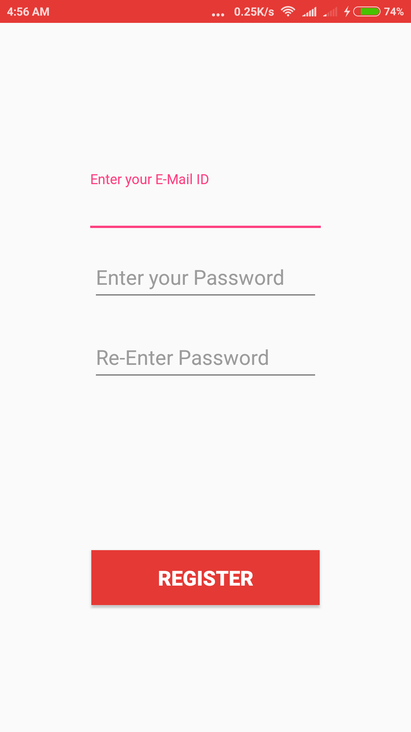
Modules :-
1. Registration panel - A unique registration panel has been created for each and every user who signs in the app . Their unique uid gets generated and stored in firebase(Backend )
PRODUCT DESCRIPTION

Slide 4
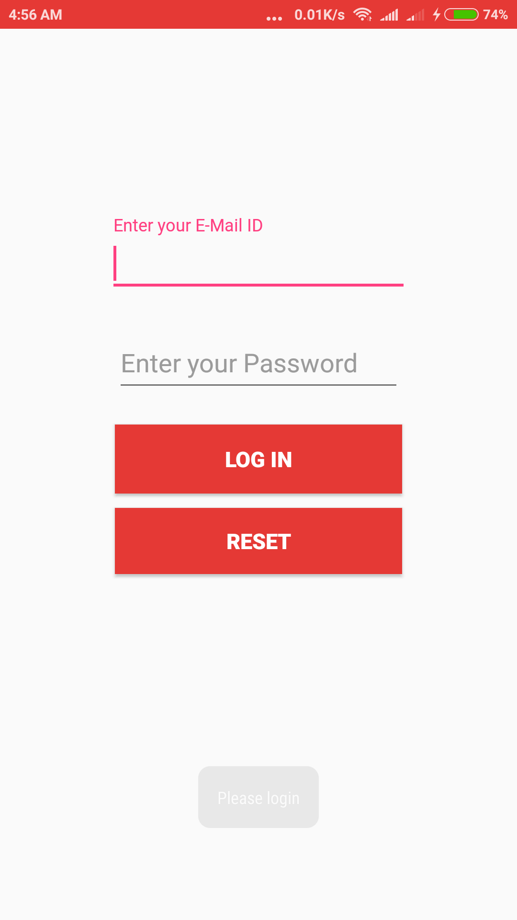
2.Login Panel - Once registered , user can login inside the application through a login panel.

Slide 5
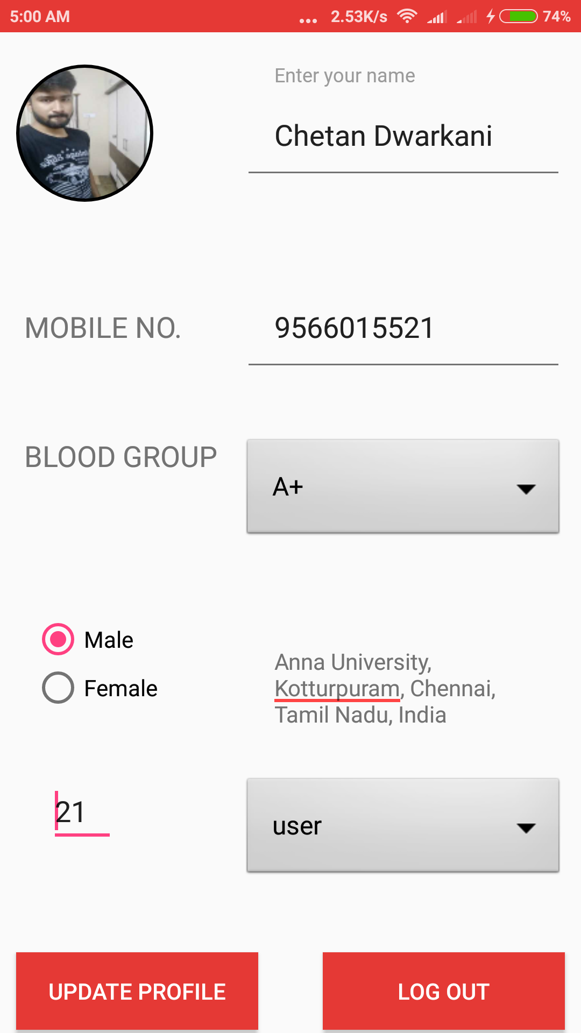
3. Profile panel - Every user holds a unique profile having all the necessary required information.

Slide 6
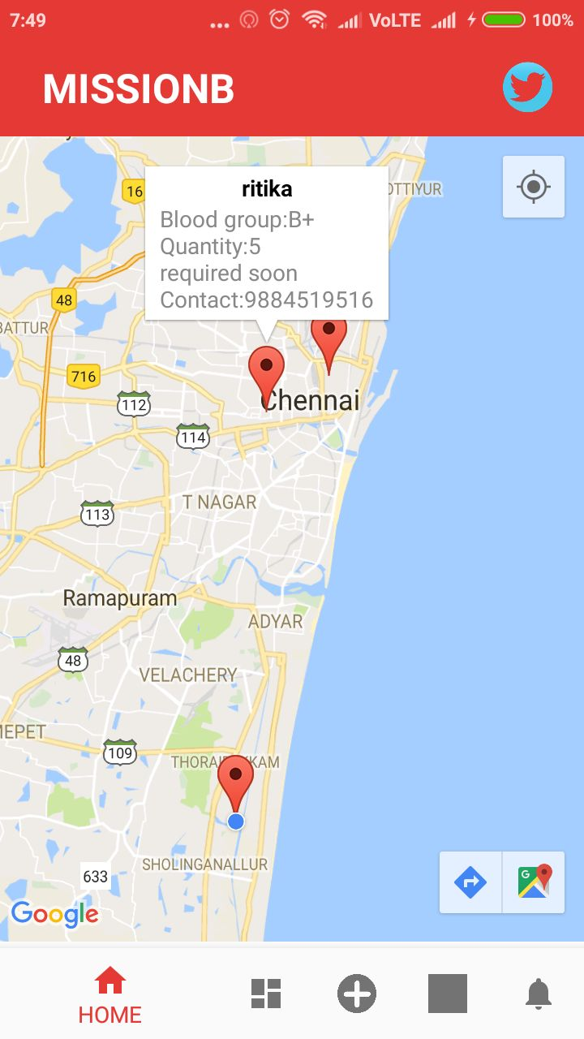
4. Maps panel - Google maps has been integrated in our app which shows complete details about user and blood banks who needs blood nearby to your location with directions.

Slide 7
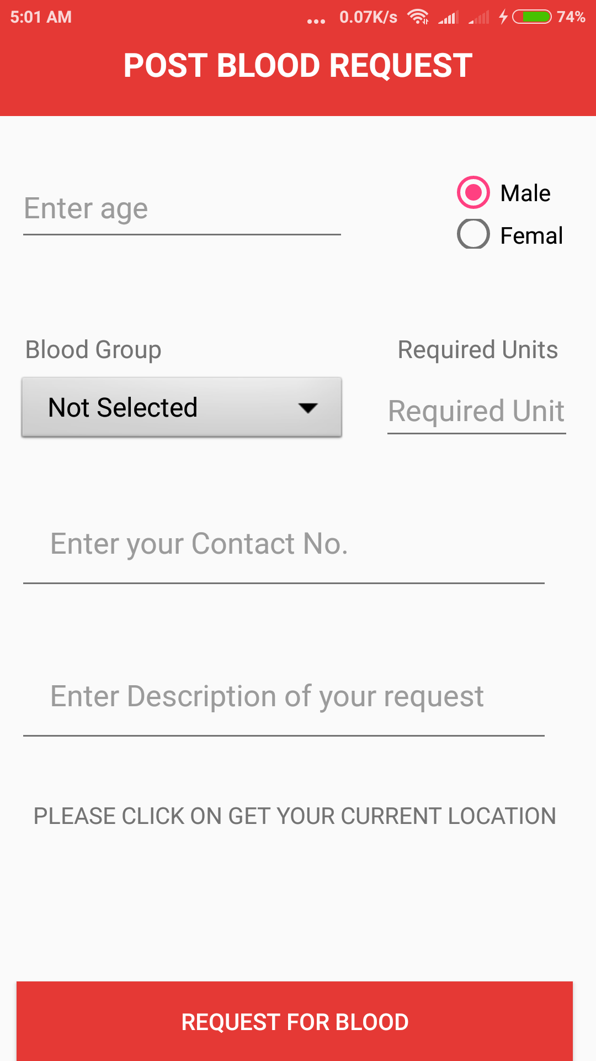
5) Blood request - Blood needy ones can post the blood request .All the data posted by blood needer gets stored in Firebase .

Slide 8
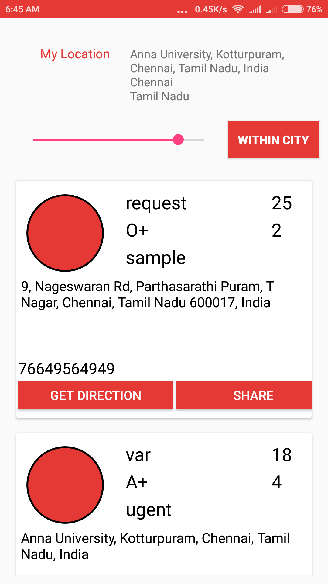
6) Blood view panel - Blood donors can see the blood request by needy ones .We have integrated Google Maps API so that the blood requesters ones can easily locate the blood donors near their very own location.

Slide 9
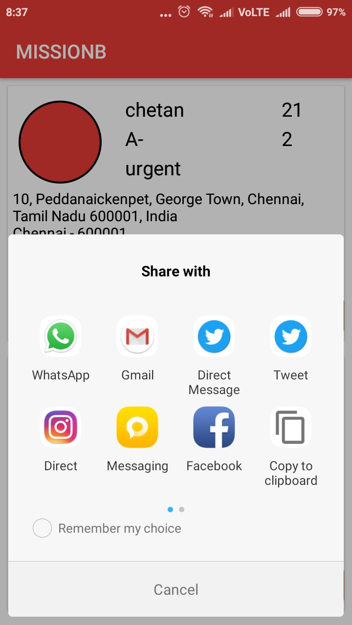
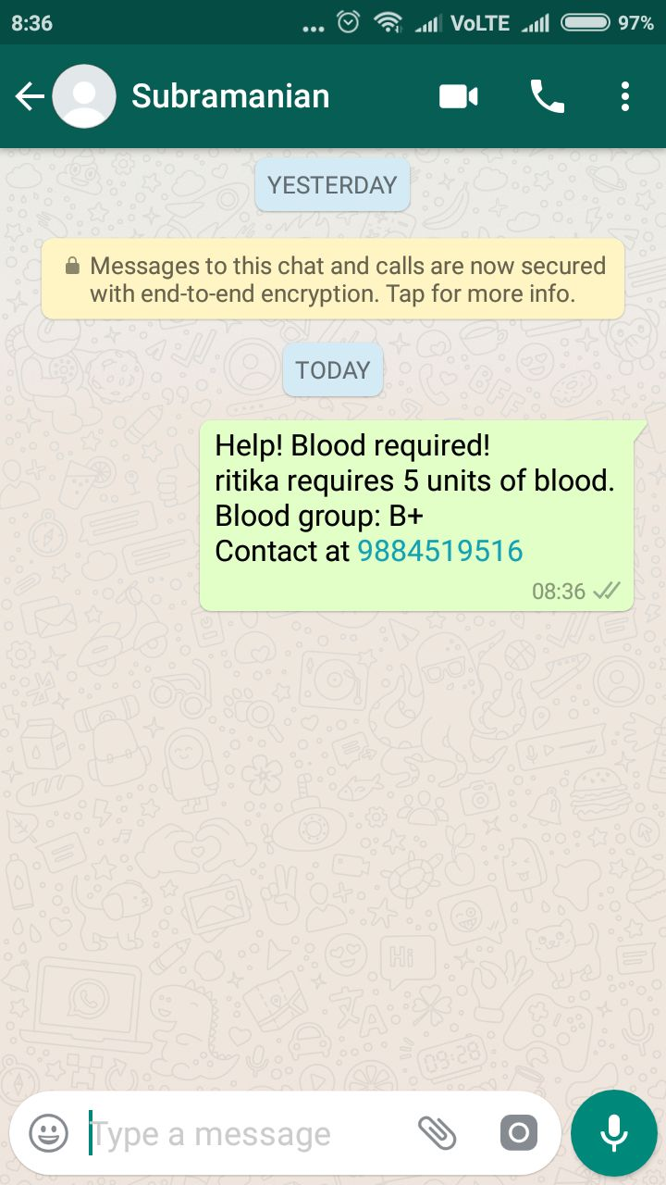
7) SHARE DATA –
We have made it easy for people to share such information with others using WhatsApp and other applications.

Slide 10
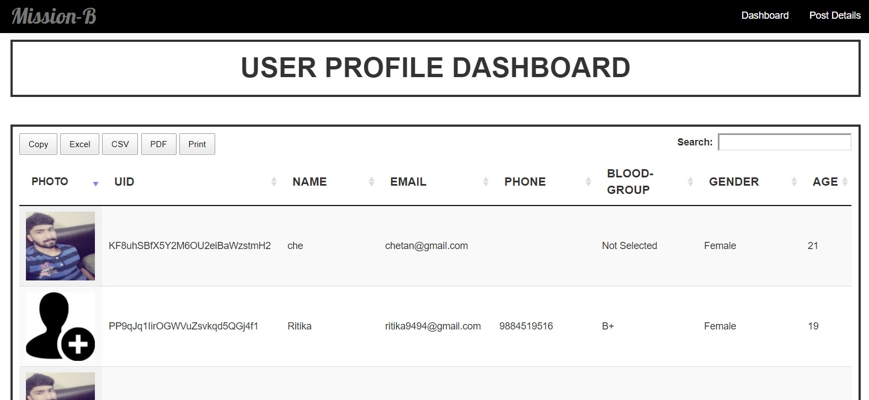
8) WEBSITE DASHBOARD-
All the user and blood request currently preset in database

Slide 11
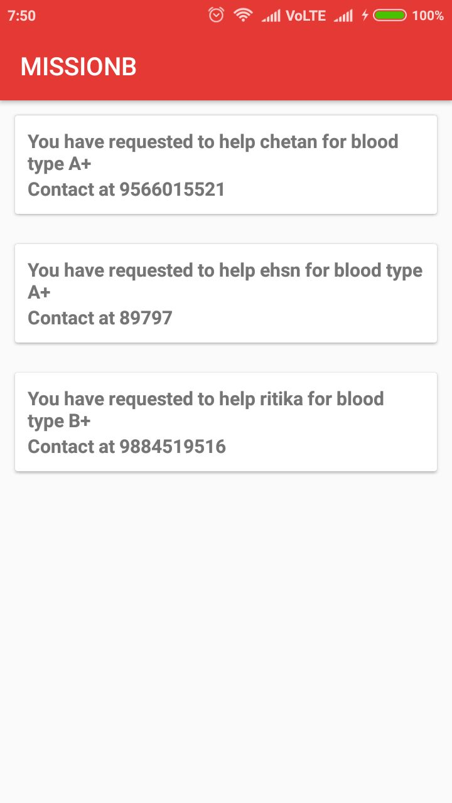
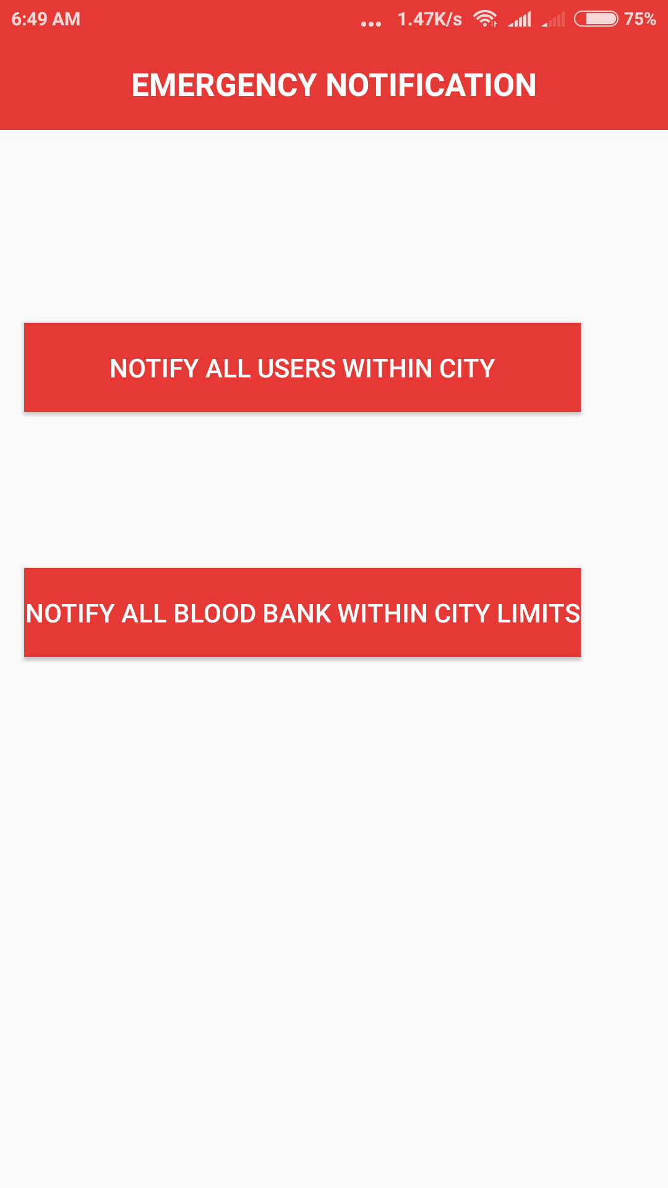
9) NOTIFICATION PANEL –
All the requests accepted are visible in this section.

Slide 12
#missionbsprite

Slide 13
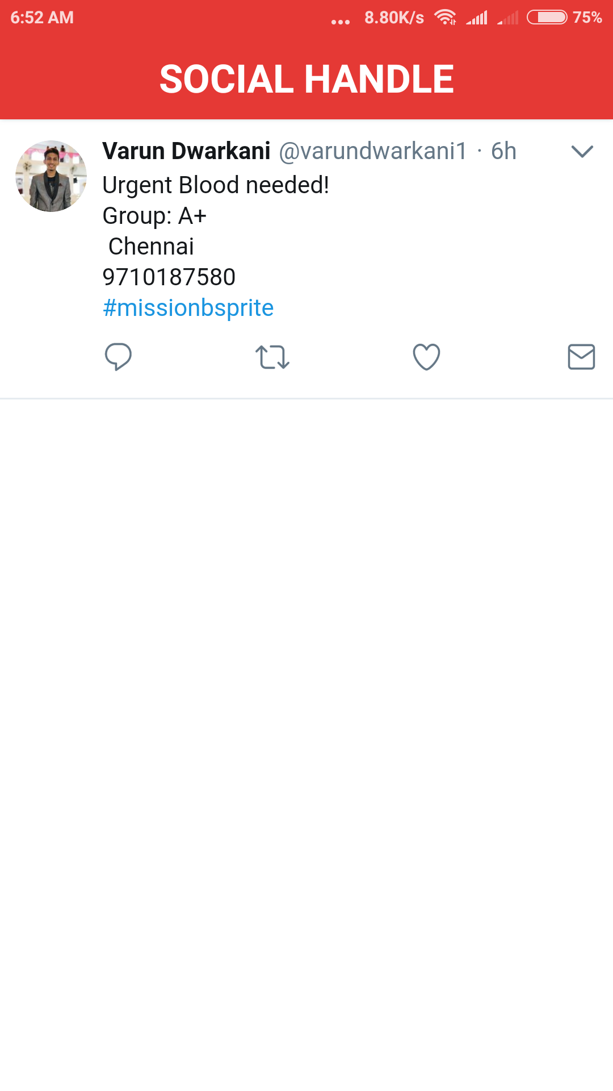
10 ) SOCIAL MEDIA CONNECT - We have connected twitter in our app so that the recent blood related tweets can be easily seen.

Slide 14
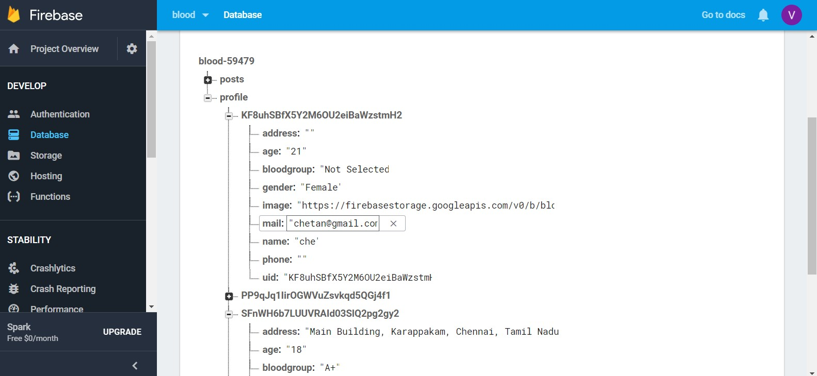
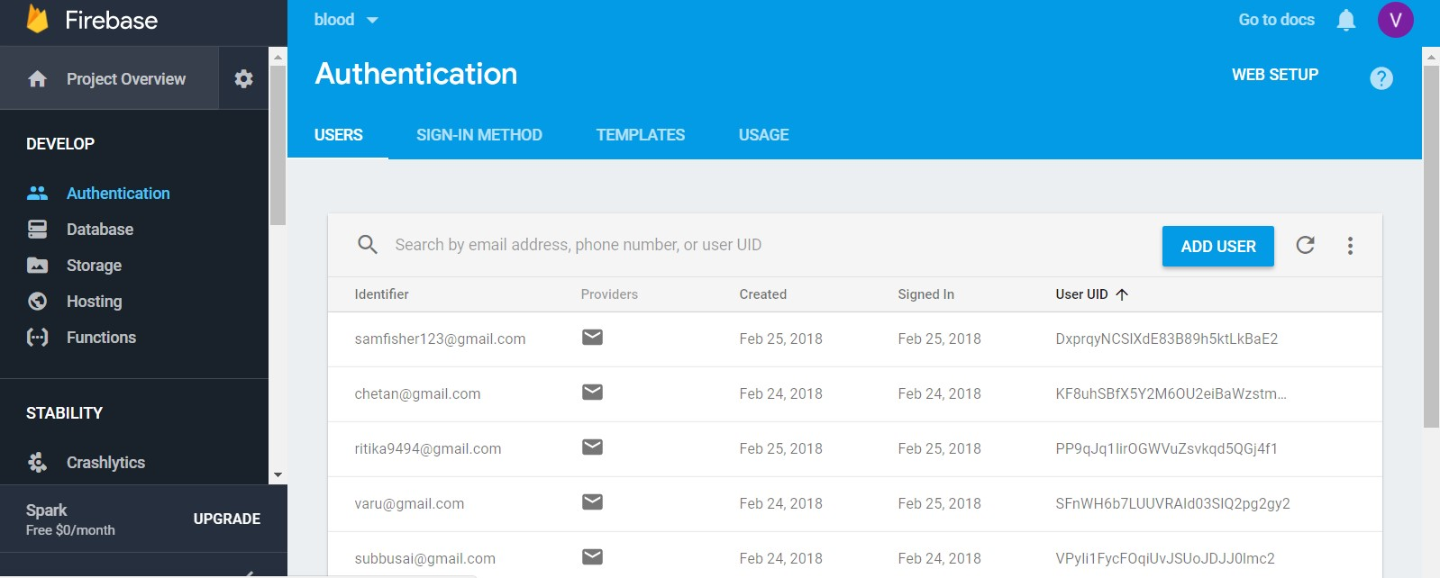
DATABASE

Slide 15
POTENTIAL USERS
The scalability of the apps is not limited to any restrictions.
It has its expansion and usage all over the public users of the
app.

Slide 16
IMPLEMENTATION
We started with creating a new project in Android Studio . Integrated the Firebase in our Android Studio and started working on designing screens and implementation. After that we integrated the Google Maps API and then started working on connecting and storing all the necessary details in firebase.

Slide 17
<How will your product influence the world ?>
Blood is one of the requirements which is always immediate.
We can never predict when a person might end up in an
accident and require the blood. Our app will definitely help
interconnecting all the blood requesters with people who are
willing to donate blood in the world.
Social impact :
Connecting all the blood needy ones with blood donors can
help to create a big change over saving lives.
IMPACT OF THE PRODUCT

